Slide 1
Real Algorithm
Just started

Slide 2
Write code following output below
Case 1
> 2
>​ A
AA
Case 2
> 5
> B
BBBBB

Slide 3
Write code following output below
Case 1
> 2
>​ 4
> AB
AABBBB
ONLY 2 LETTER ALLOW
Case 2
> 5
> 2
> EF
EEEEEFF

Slide 4
Write code following output below
Case 1
> 2
>​ 4
> AB
AABBBBBBBB
ONLY 2 LETTER ALLOW
Case 2
> 2
> 2
> EF
EEFFFF

Slide 5
Write code following output below
Case 1
> 4
>​ Enter: 2
>​ Enter: 4
>​ Enter: 4
>​ Enter: 6
Sum: 16
Case 2
> 2
>​ Enter: 2
>​ Enter: 4
Sum: 6

Slide 6
Write code following output below
Case 1
>​ Enter: Hello
>​ Enter: Hi
>​ Enter: Morning
>​ Enter: Good night
Result: Hello, Hi, Morning, Good night
Allow only one print
Case 2
>​ Enter: Yes
>​ Enter: Hi
>​ Enter: Not well
>​ Enter: Okay
Result: Yes, Hi, Not well, Okay

Slide 7
Write code following output below
Case 1
>​ Enter: abc93sa
Number: 93
Text: abcsa
Case 2
>​ Enter: 192abcfj99
Number : 19299
Text: abcfj

Slide 8
Write code following output below
Case 1
>​ Enter: abc93sa
Sum: 12
Text: abcsa
Case 2
>​ Enter: 192abcfj99
Sum : 30
Text: abcfj

Slide 9
Write code following output below
Case 1
>​ Enter: 98473521
12345789
Case 2
>​ Enter: 1923849
1234899

Slide 10
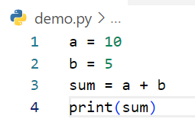
Write step following code below
Step | a | b | sum | output
1 | 10
2 | 10 | 5
3 | 10 | 5 | 15
4 | 10 | 5 | 15 | 15
Example

Slide 11
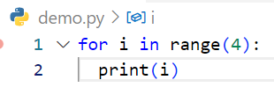
Write step following code below
Step | i | output
1 | 0
2 | 0 | 0
3 | 1
4 | 1 | 1
5 | 2
6 | 2 | 2
7 | 3
8 | 3 | 3

Slide 12
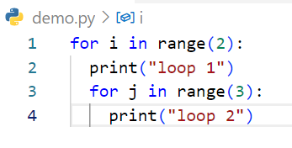
Write step following code below
Step | i | j | output
1 | 0
2 | 0 |  | loop1
3 | 0 | 0
4 | 0 | 0 | Loop2
5 | 0 | 1
6 | 0 | 1 | Loop2
7 | 0 | 2
8 | 0 | 2 | Loop2
9 | 1
10 | 1 |  | Loop1
11 | 1 | 0
12 | 1 | 0 | Loop2
13 | 1 | 1
14 | 1 | 1 | Loop2
15 | 1 | 2
16 | 1 | 2 | Loop2

Slide 13
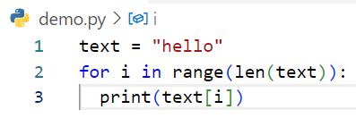
Write step following code below
Step | text | i | output
1 | Hello
2 | hello | 0
3 | hello | 0 | h
4 | hello | 1
5 | Hello | 1 | e
6 | hello | 2
7 | hello | 2 | L
8 | hello | 3
9 | hello | 3 | L
10 | hello | 4
11 | hello | 4 | 0

Slide 14
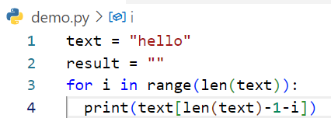
Write step following code below
Step | i | text | result | output
1 |  | Hello
2 |  | Hello | “”
3 | 0 | hello | “”
4 | 0 | hello | “” | O
5 | 1 | hello | “”
6 | 1 | hello | “” | L
7 | 2 | Hello | “”
8 | 2 | hello | “” | L
9 | 3 | hello | “”
10 | 3 | hello | “” | E
11 | 4 | hello | “”
12 | 4 | hello | “” | h

